Slide 1
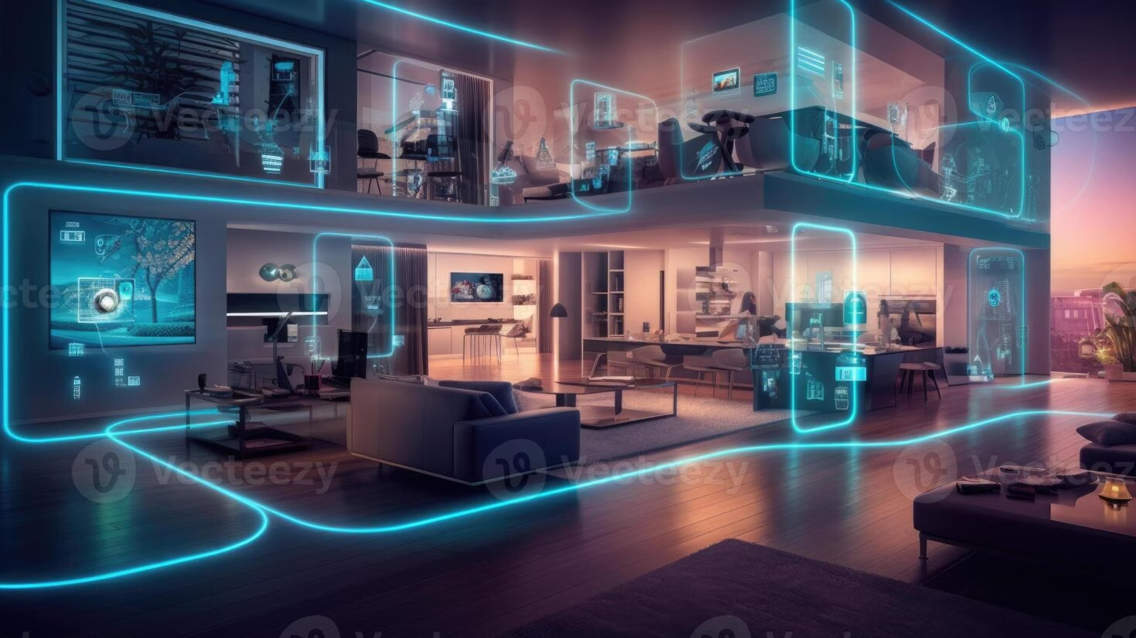
Edge-AI Assisted Occupancy-Adaptive Climate Control System
An innovative IoT solution that intelligently adjusts indoor climate based on real-time environmental and occupancy data, leveraging Edge AI (TinyML) for efficient energy use and enhanced comfort.

Slide 2
Project Overview & Objectives
The Edge-AI Assisted Occupancy-Adaptive Climate Control System is an innovative IoT solution that intelligently adjusts the indoor climate based on real-time environmental and occupancy data. By leveraging Edge AI (TinyML), the system can predict user comfort levels locally on the ESP32, without relying heavily on cloud servers. This adaptive system ensures efficient energy use, providing comfort when needed and saving power when the room is unoccupied.
Key Objectives
IoT-based Climate Control
Edge AI with TinyML
Automatically adjusts the indoor environment based on temperature, humidity, light levels, and occupancy.
Implement local machine learning (TinyML) on ESP32 for comfort prediction without cloud dependency.
Occupancy Detection
Energy Efficiency
Accurate detection of human presence using PIR sensors to control HVAC devices (fan/AC).
Prevents unnecessary HVAC operation in unoccupied rooms, reducing energy consumption.

Slide 3

Project Team & Responsibilities
Wania Zainab
Shamaim Khan
Hardware Integration (Sensors, Relays, OLED)
Cloud & Database Setup (Blynk + Dashboard)
Firmware Development (ESP32, TinyML model)
Testing, Validation & Documentation

Slide 4
Hardware Components
ESP32 Dev Module
The main controller that runs the TinyML model for comfort prediction.
DHT11 Sensor
Temperature and humidity sensor to monitor indoor conditions.
PIR Sensor
Detects human presence to trigger HVAC operation only when the room is occupied.
LDR (Light Sensor)
Measures ambient light levels to adjust the HVAC for optimal comfort.
Relay Module
Controls the switching of HVAC devices (fan/AC) based on ESP32's decisions.
OLED Display
Displays real-time system status and environmental data.
Power Source
USB or battery to power the system.

Slide 5

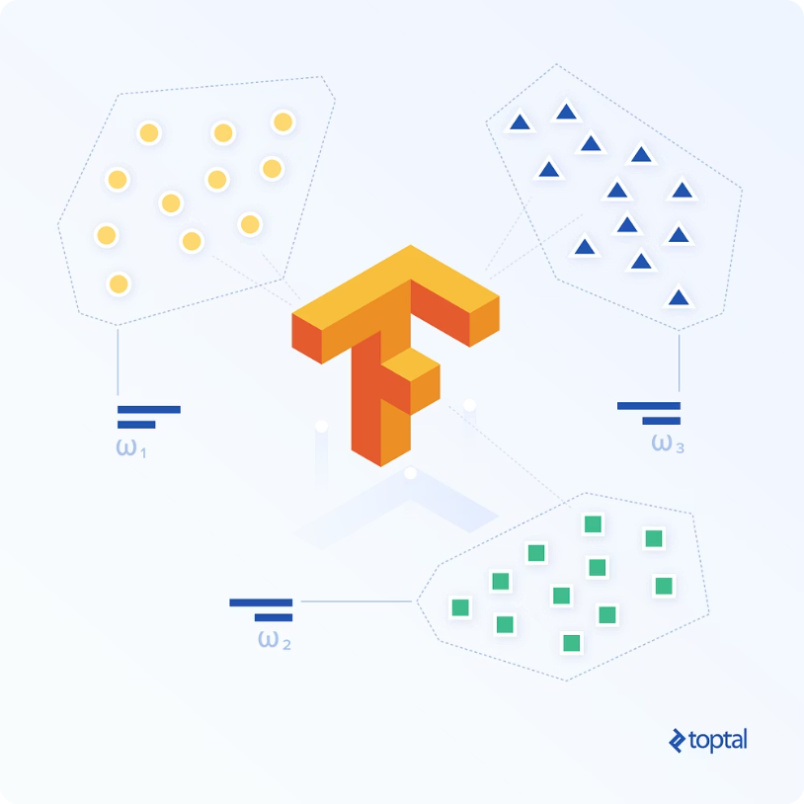

Software Stack
The system leverages a robust software stack to enable efficient firmware development, TinyML deployment, and cloud integration for monitoring and control.
PlatformIO / Arduino IDE
TinyML / TensorFlow Lite Micro
Blynk Cloud
Integrated Development Environment used for writing and uploading the firmware to the ESP32.
Cloud platform for storing real-time data, logs, and providing a mobile/web dashboard for system control and monitoring.
Lightweight machine learning framework for deploying inference models directly on microcontrollers.

Slide 6
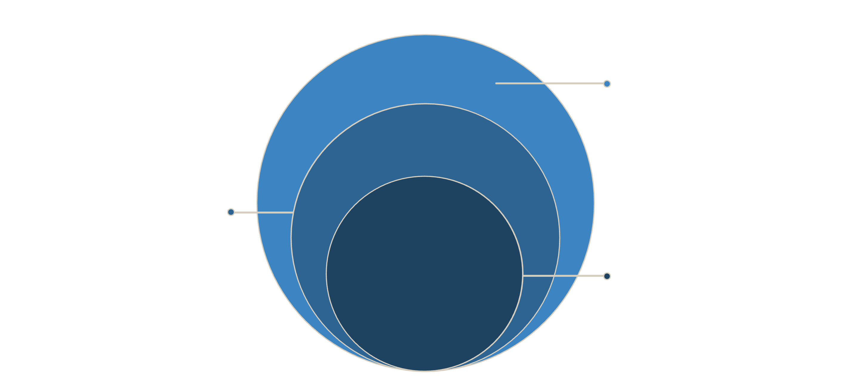
System Architecture Diagram
Cloud & UI
Real-time storage, dashboard, mobile/web controls
Edge Processing
ESP32, TinyML, relays, OLED, cloud logging
Core Sensors
DHT11, PIR, LDR feed measurements
This architectural breakdown illustrates the interconnected components and data flow, from sensor input to user interaction, ensuring a comprehensive and efficient climate control solution.

Slide 7
Data Flow & System Workflow
The system operates through a seamless data flow, enabling adaptive climate control based on real-time conditions and user input.
Sensors
ESP32 (Edge AI)
DHT11, PIR, and LDR collect real-time environmental and occupancy data.
Reads sensor data, runs TinyML model, activates HVAC via relay, updates OLED, and sends logs to Blynk.
Blynk Cloud
User Interface
Stores historical data and provides real-time access via web/mobile dashboard.
Users view system status and override settings through the dashboard.
System Workflow
01
02
03
System Initialization
Comfort Prediction
Occupancy Detection
ESP32 starts collecting and displaying sensor data on the OLED.
TinyML model predicts comfort; if below threshold, HVAC is triggered.
PIR sensor checks for presence; if unoccupied, HVAC turns off to save energy.
04
05
Data Logging
User Interaction
Environmental data is sent to Blynk for remote monitoring and analysis.
Users can manually adjust or override settings via the Blynk dashboard.

Slide 8
Testing & Validation
Hardware Testing
Firmware Testing
Sensor Calibration: Ensure accurate readings from DHT11, PIR, and LDR sensors.
TinyML Accuracy: Validate the accuracy of the comfort prediction model on the ESP32.
Relay Testing: Confirm that the relay activates/deactivates the HVAC system correctly.
Occupancy Detection: Test the PIR sensor to ensure HVAC activation only when the room is occupied.
OLED Display: Check if the display updates correctly with system data.
Cloud Integration: Verify data logging and real-time monitoring via Blynk.
Energy Efficiency Testing
HVAC Control: Ensure the system reduces energy consumption by turning off HVAC in unoccupied rooms, aligning with the project's energy-saving goals.

Slide 9
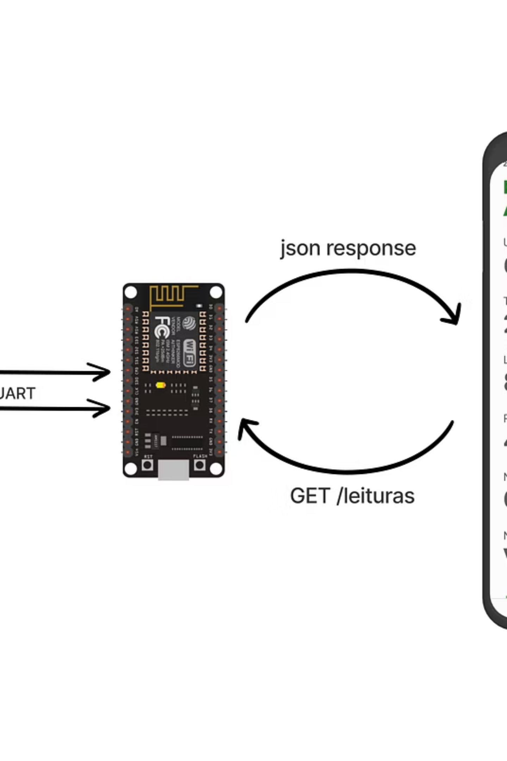
Project Demo
Witness the Edge-AI Assisted Occupancy-Adaptive Climate Control System in action! This demo showcases the seamless integration of hardware and software, providing intelligent climate control that adapts to its environment.
Real-time Sensor Data: Observe temperature, humidity, and light levels updating instantly on the OLED display and Blynk dashboard.
Occupancy-Based HVAC Control: See the system respond to presence detection, activating or deactivating the fan/AC accordingly.
TinyML in Action: Understand how the on-device AI makes comfort predictions without cloud latency.
Remote Monitoring & Override: Interact with the system via the Blynk mobile dashboard to view status and manually adjust settings.

Slide 10
Conclusion & Future Work
The Edge-AI Assisted Occupancy-Adaptive Climate Control System efficiently integrates IoT and AI to provide an intelligent climate control solution. By deploying TinyML on the ESP32, the system operates autonomously without heavy reliance on the cloud, ensuring a smooth and energy-efficient experience.
This project represents a significant step toward smarter, more energy-efficient homes and workspaces, reducing unnecessary HVAC operation and making indoor environments more comfortable and sustainable.
Model Enhancement
Integration with Smart Devices
Continuously train the TinyML model with more environmental data to improve comfort prediction accuracy.
Future versions could integrate with other smart home devices for even more comprehensive automation.

Slide 11
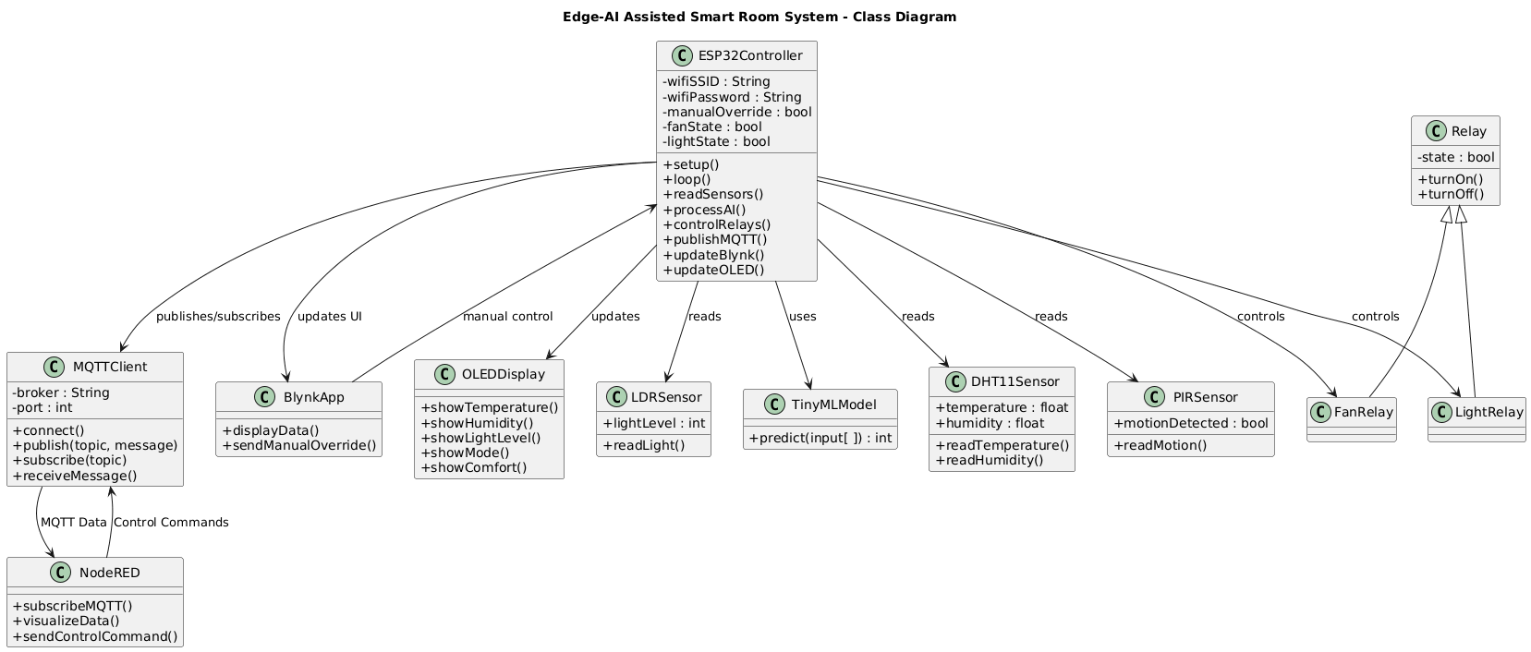
Class Diagram

Slide 12
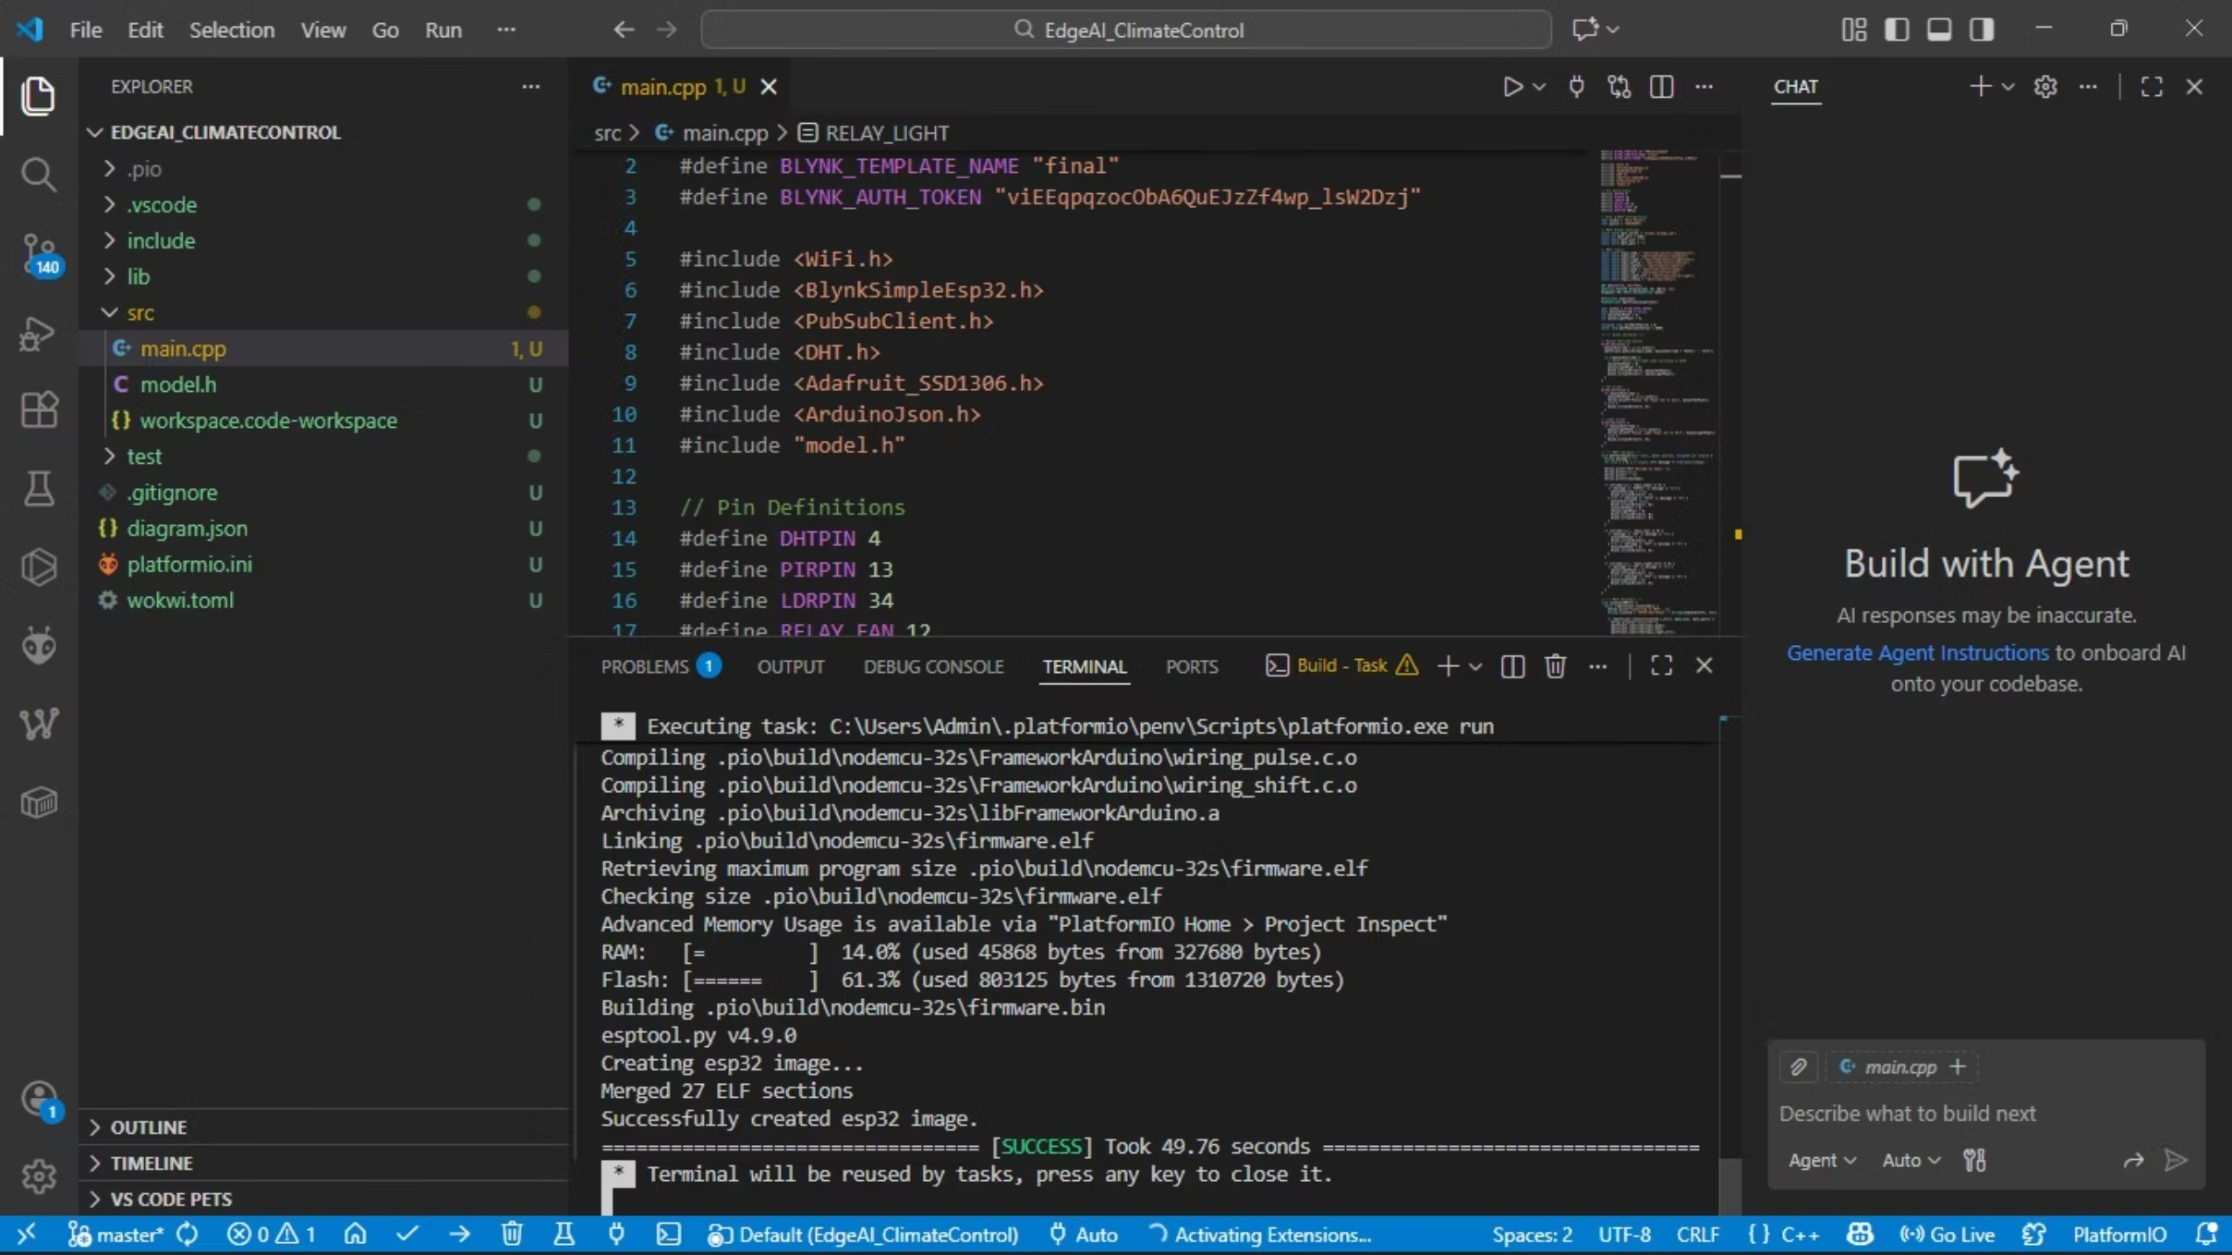
Running code

Slide 13
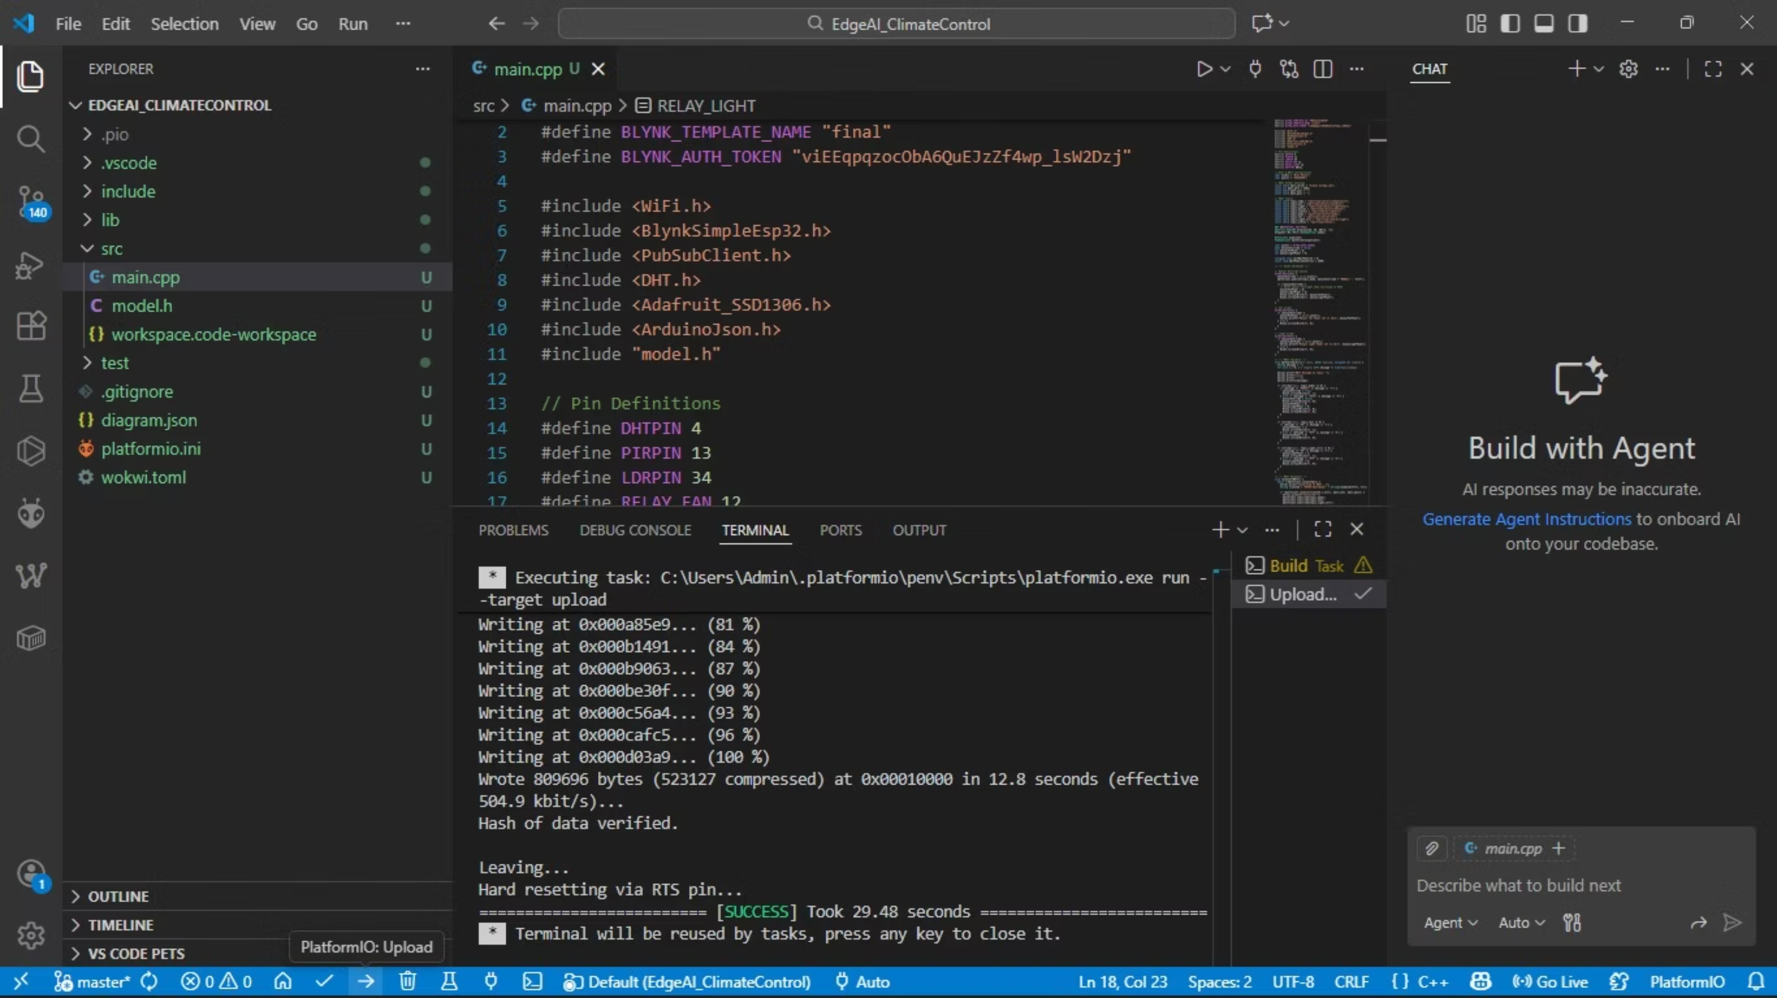

Slide 14
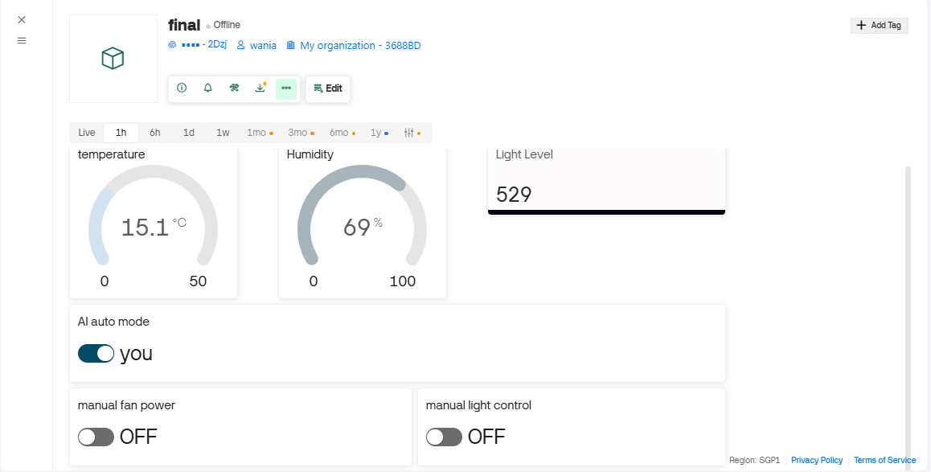
Blynk Dashboard

Slide 15
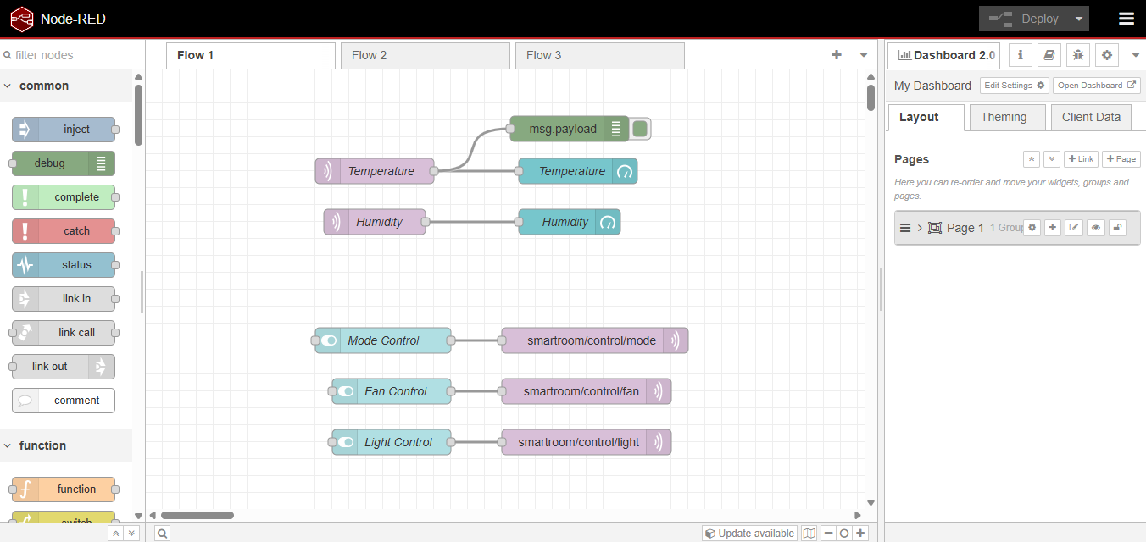
Node-Red Dashboard

Slide 16
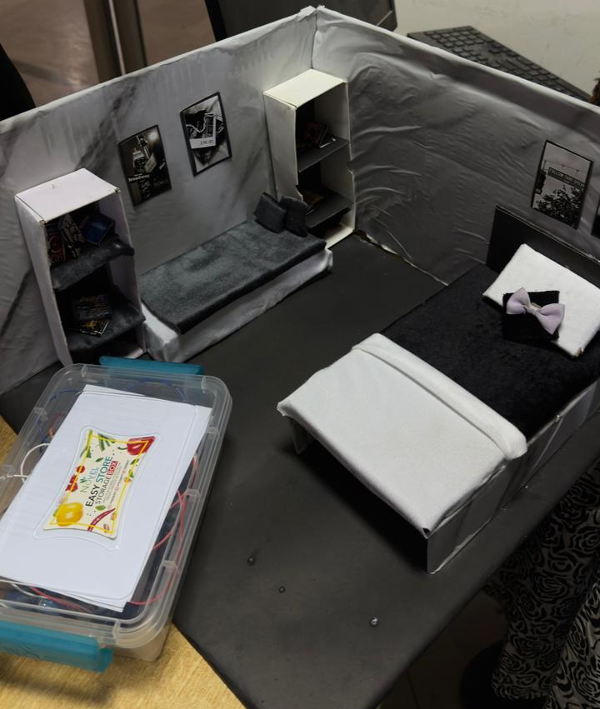
Prototype

Slide 17
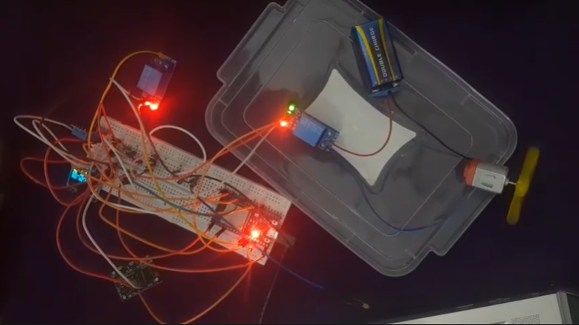
Working System

